Slide 1
ÓBUDA UNIVERSITY
BÁNKI DONÁT FACULTY
of
Mechanical and Safety Engineering
EDUCATION AND
RESEARCH ACTIVITIES

Slide 2
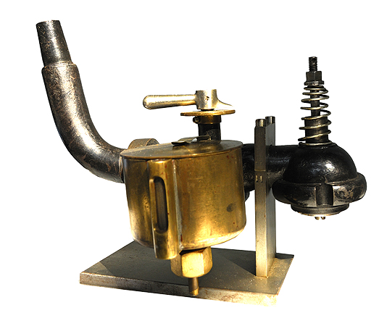
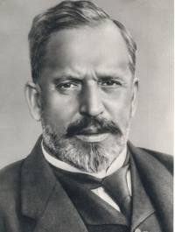
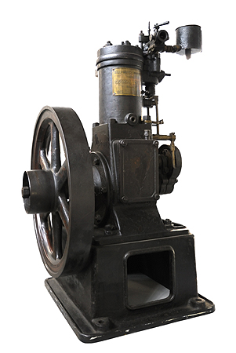
Traditions and modern developments since 1879
Did you know that the carburetor was invented by a Hungarian engineers?
Donát BÁNKI together with János CSONKA was inventor of the carburetor, in 1893. It is often, incorrectly credited to Wilhelm Maybach, who submitted his patent half a year after Bánki.

Slide 3
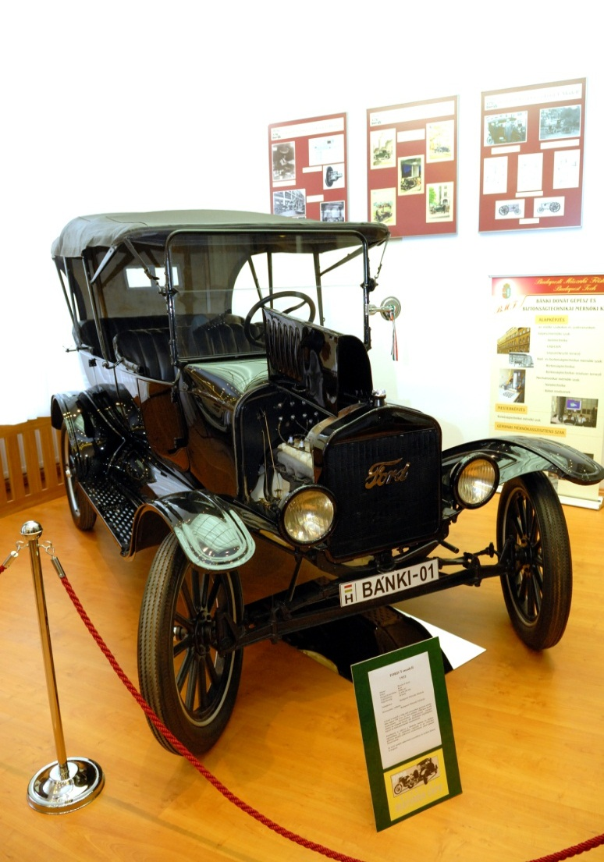
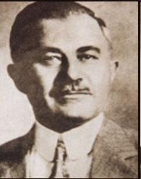
Traditions and modern developments since 1879
Did you know that Chief Designer of Ford Model T was the most famous alumnus of our Faculty József GALAMB?

Slide 4
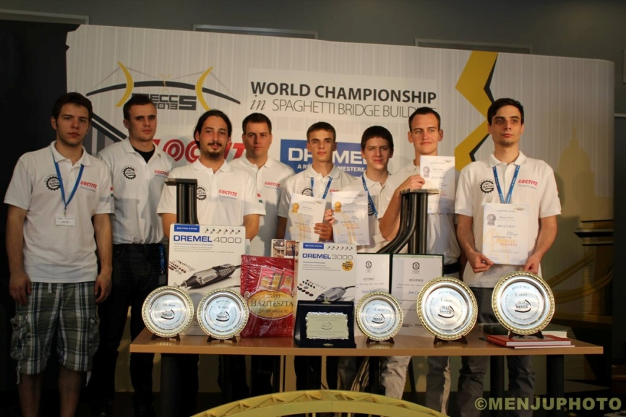
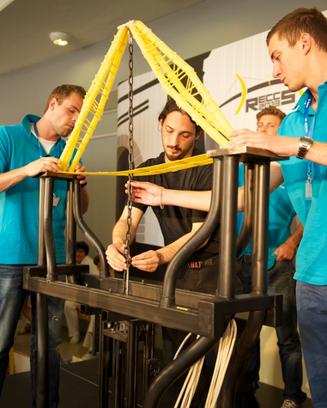
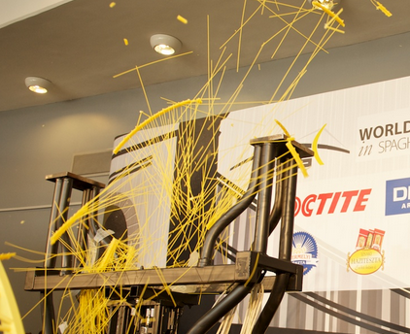
Traditions and modern developments since 1879
Spaghetti Bridge Building
World records (held by our students):
bridge: 570,3 kg
support: 611,8 kg

Slide 5
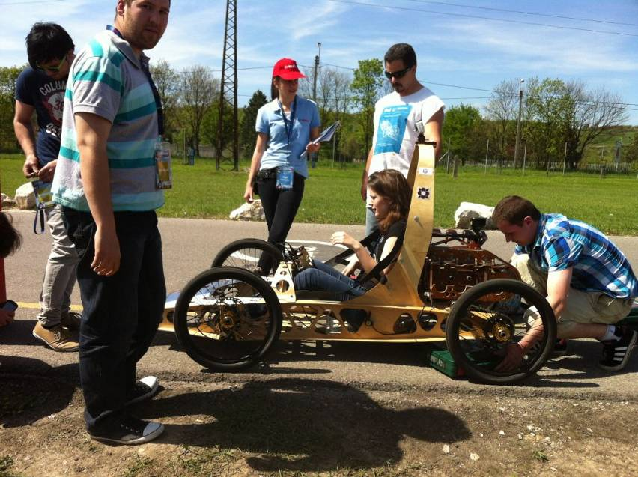
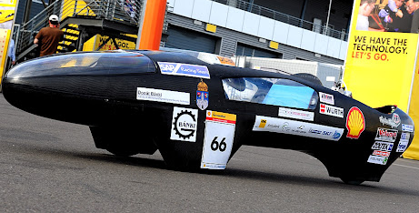
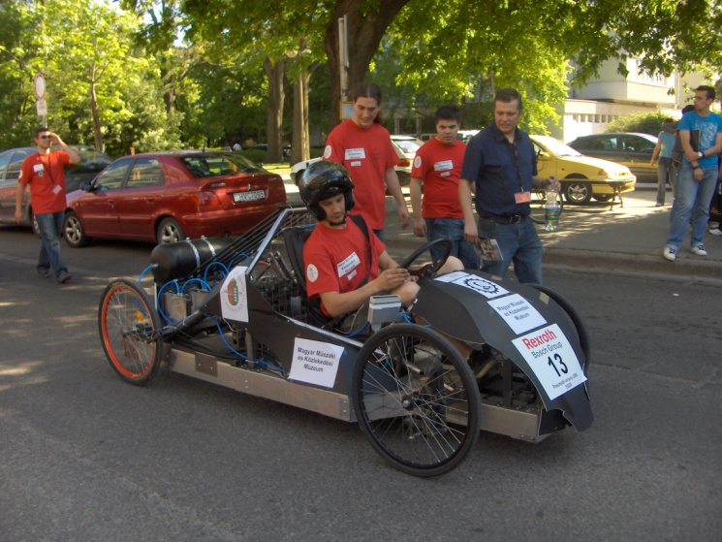
Traditions and modern developments since 1879
Rexroth Pneumobil
Car for Shell Eco-marathon
2015: 565.5 km/l
engine of a Honda lawnmower

Slide 6
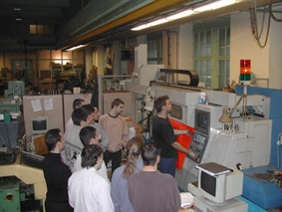
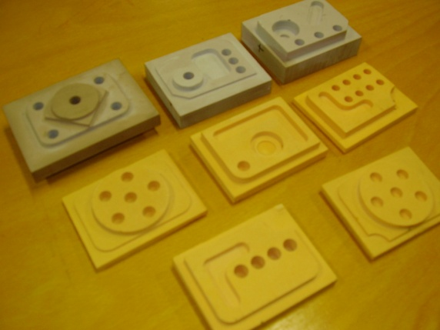
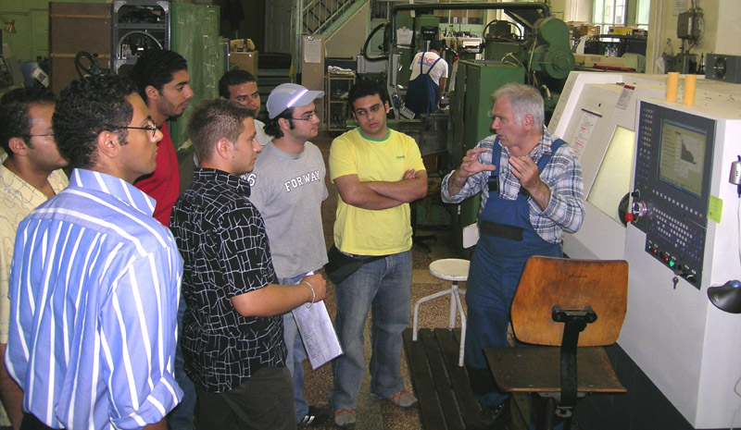
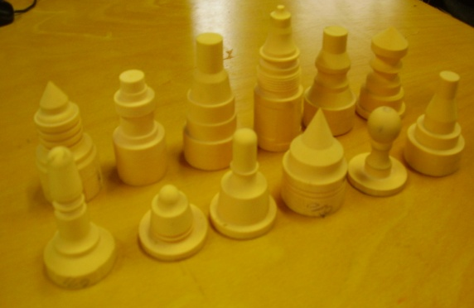
Educational programs of the Faculty
Practice oriented education

Slide 7
Educational programs of the Faculty
Bologna system of education
BSc: full-time, correspondence, and part-time course;
7 semesters
MSc: full-time, and correspondence course;
4 semesters
PhD: full-time, and correspondence course;
6 (8) semesters

Slide 8
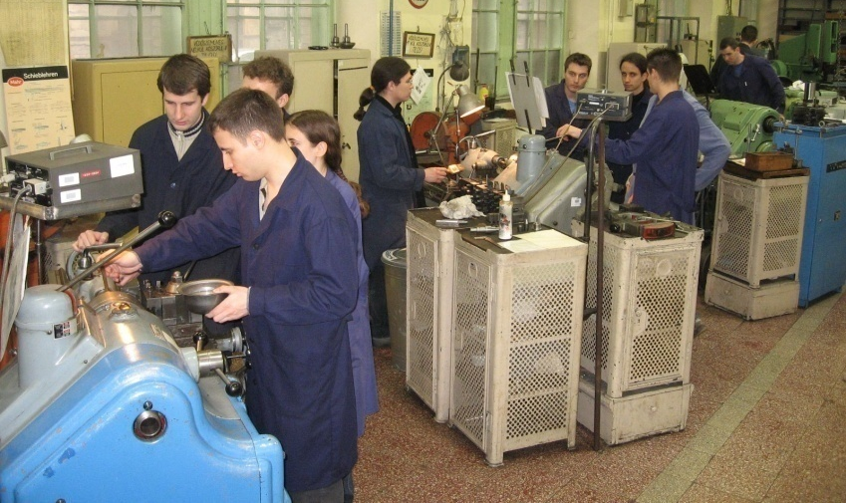
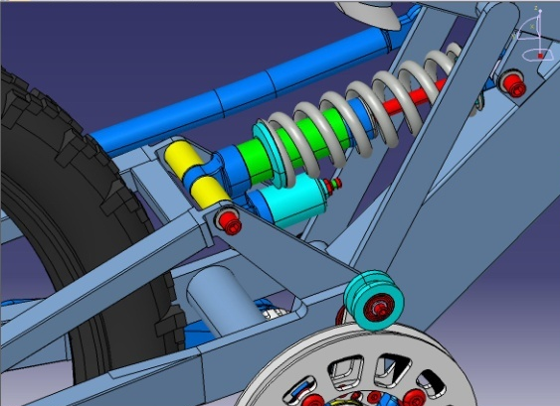
Educational programs of the Faculty
Mechanical engineering (BSc, MSc)
CAD/CAM
Machine construction
Vehicles engineering
Mechatronics (BSc, MSc, in English as well)
Safety engineering (BSc, MSc)
Security and safety science (PhD)
Number of fresh students: 850 / year
Number of students total: 3000

Slide 9
Educational programs of the Faculty
Development of enrolled student
Full-time
Part-time
Postgraduate education

Slide 10
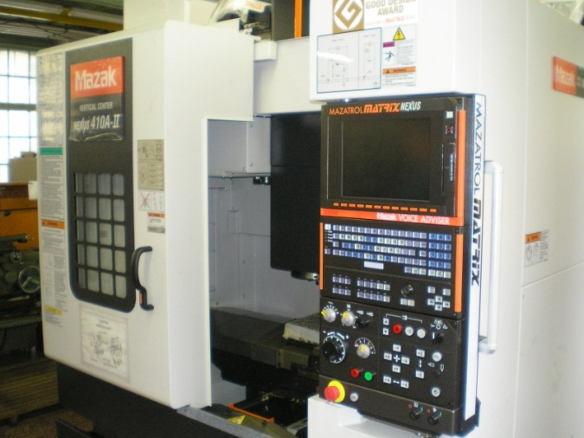
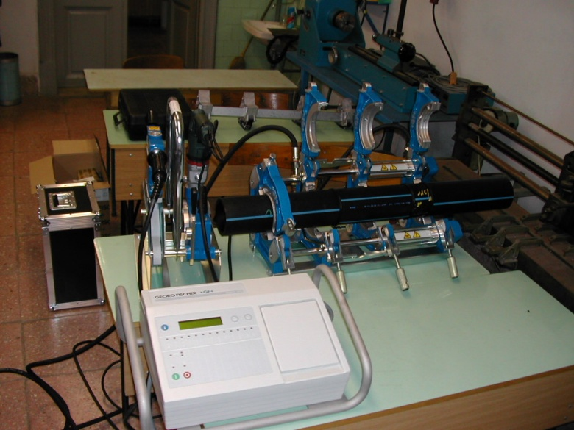
Institutes of the Faculty
Institute of Mechatronics and Vehicle Engineering
Dr. László POKORÁDI, PhD
Institute of Machine Design and Safety Engineering
Dr. Árpád CZIFRA, PhD
Institute of Material Science and Manufacturing Engineering
Dr. Mihály RÉGER, DSc

Slide 11
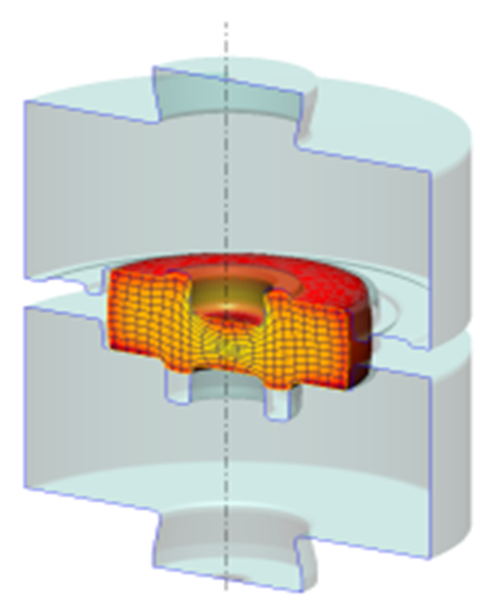
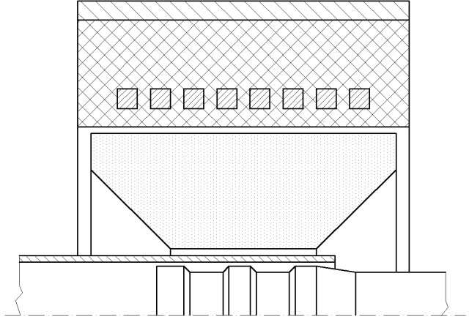
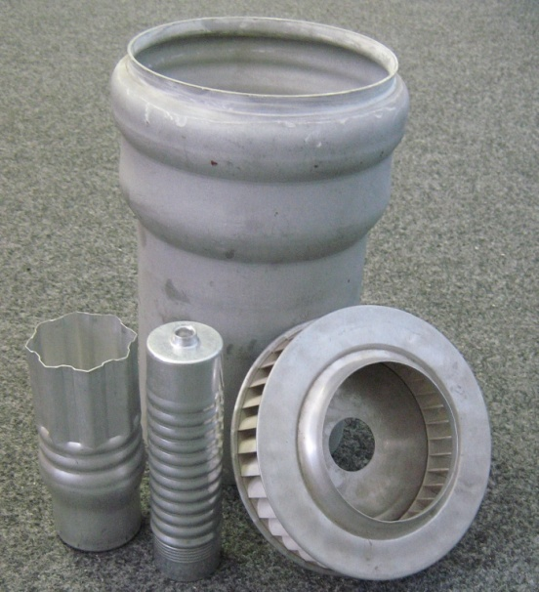
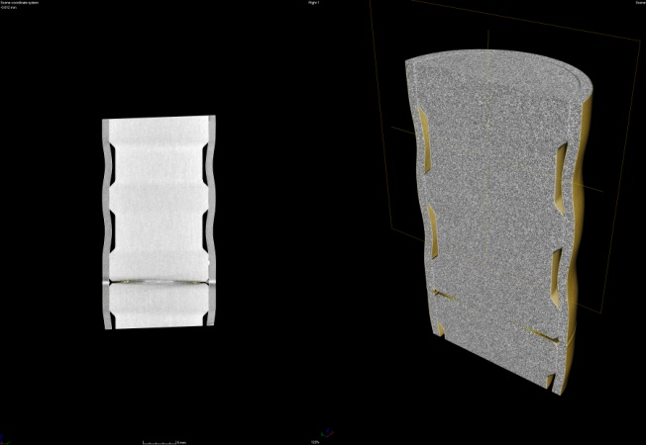
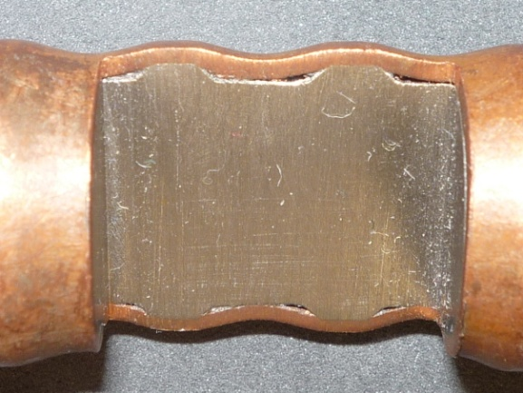
Materials Science and Manufacturing Engineering
Metal forming processes and technologies
Electromagnetic forming
FEM analysis of metal forming processes

Slide 12
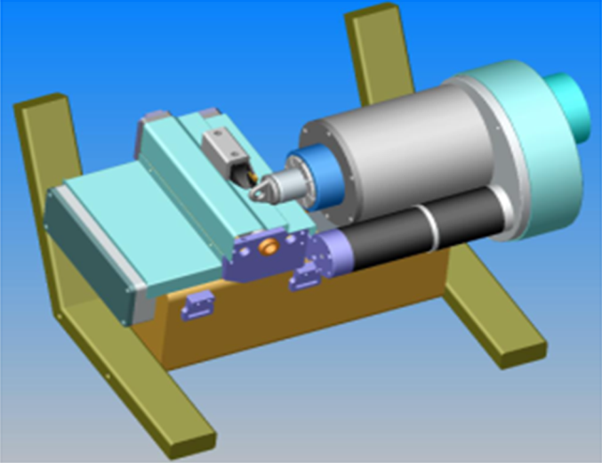
Materials Science and Manufacturing Engineering
Welding and material testing (soudage)
Design of special material testing equipment
Robot welding laboratory by CLOOS

Slide 13
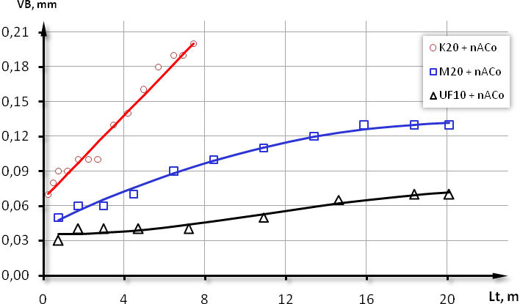
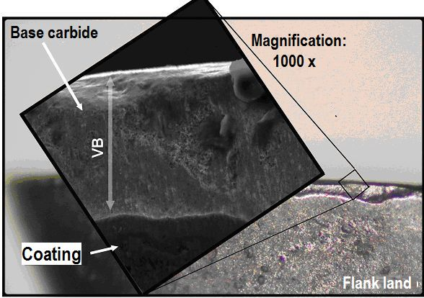
Materials Science and Manufacturing Engineering
Wear process of nanocomposite coated insert
Build-up edge on the rake face

Slide 14
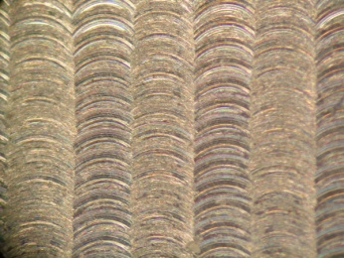
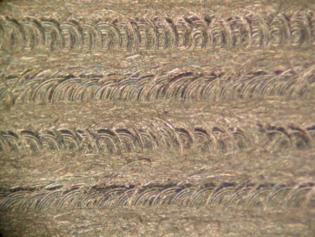
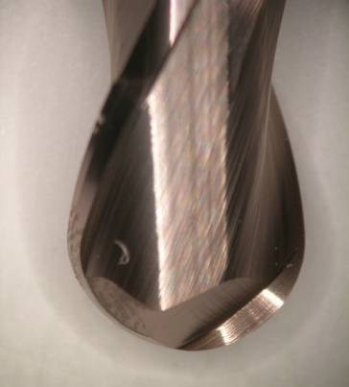
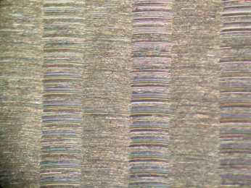
Materials Science and Manufacturing Engineering
3D surface milling, visual analysis
Material: 42CrMo4 (1.7225)
Z2/N1
Z5/N1
a_{e}
Z2/N3
Z5/N3
a_{e}

Slide 15
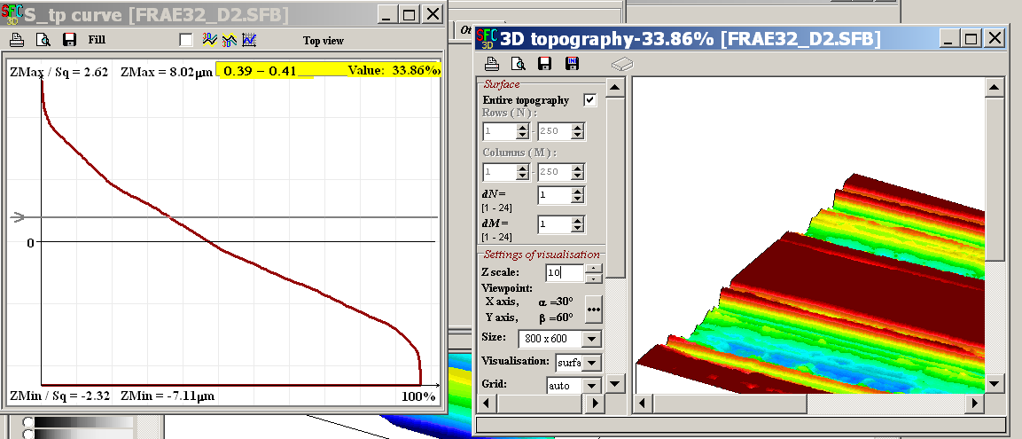
Materials Science and Manufacturing Engineering
Characterization of engineering surfaces by micro- topography
Autocorrelation topography
Height distribution curve
Bearing area curve

Slide 16
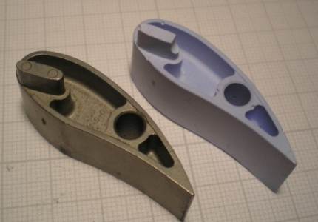
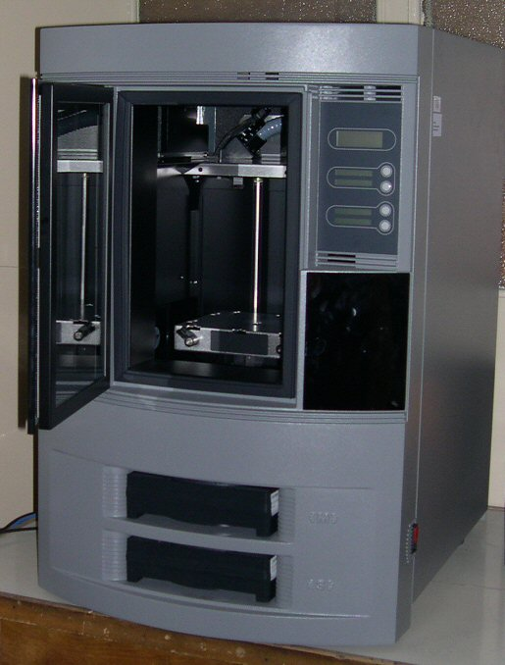
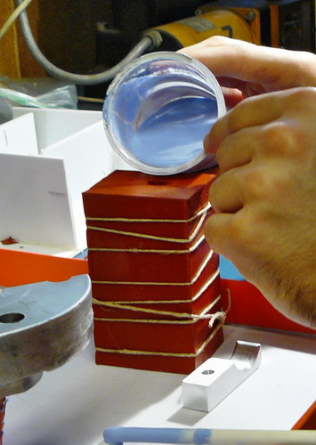
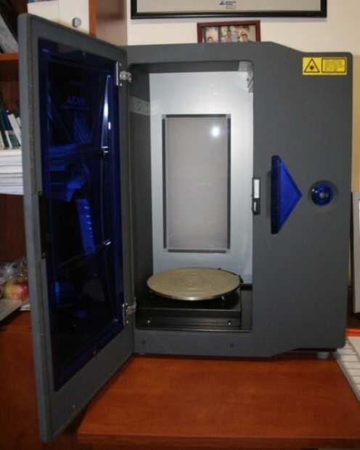
Materials Science and Manufacturing Engineering
Rapid prototyping facilities
ABS plastic models
Silicone mold
Dimension BST 768
Roland LPX-250
3D Laser scanner

Slide 17
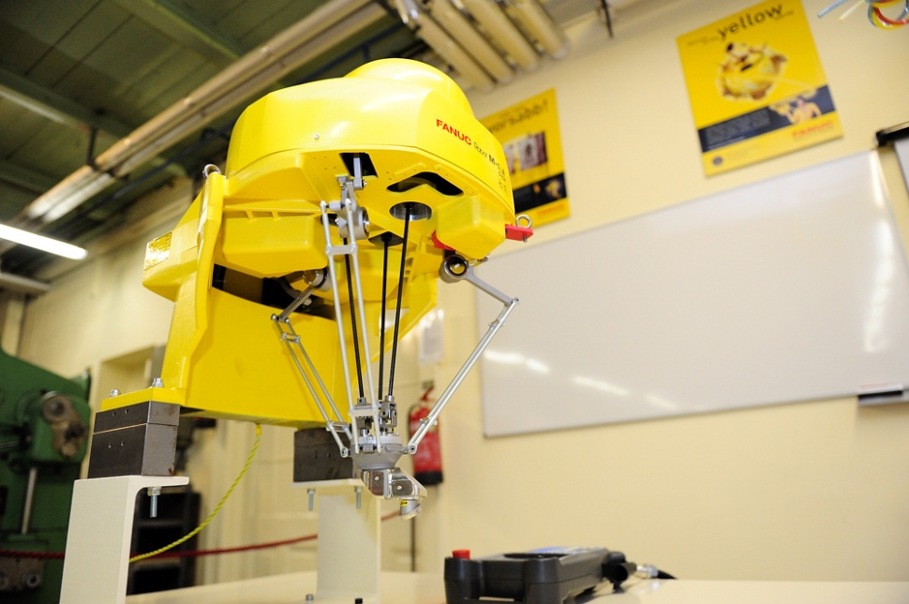
Materials Science and Manufacturing Engineering
FANUC Research and Education Robot Laboratory
Established in 2012
Two up to date robots
Machining and work piece handling
Robot vision research

Slide 18
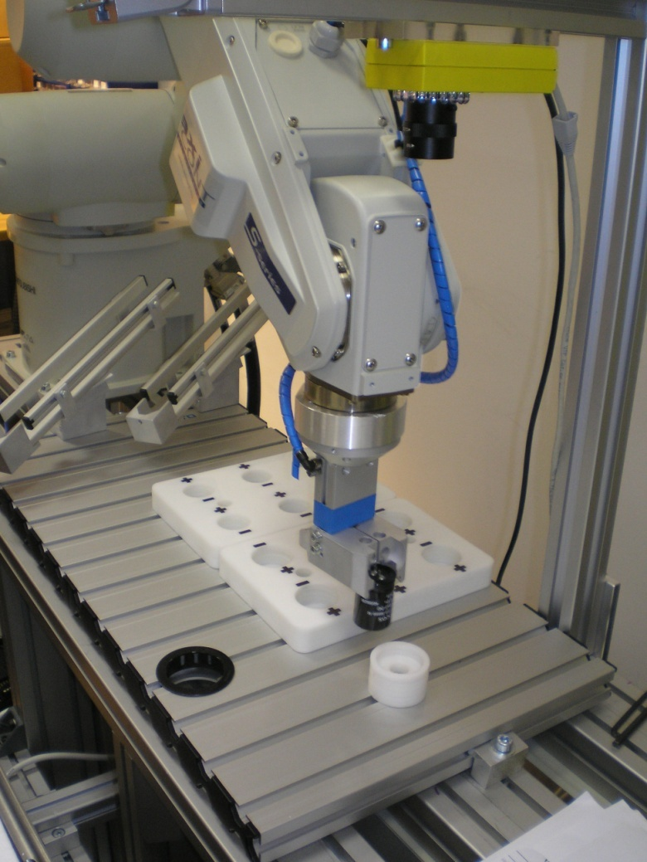
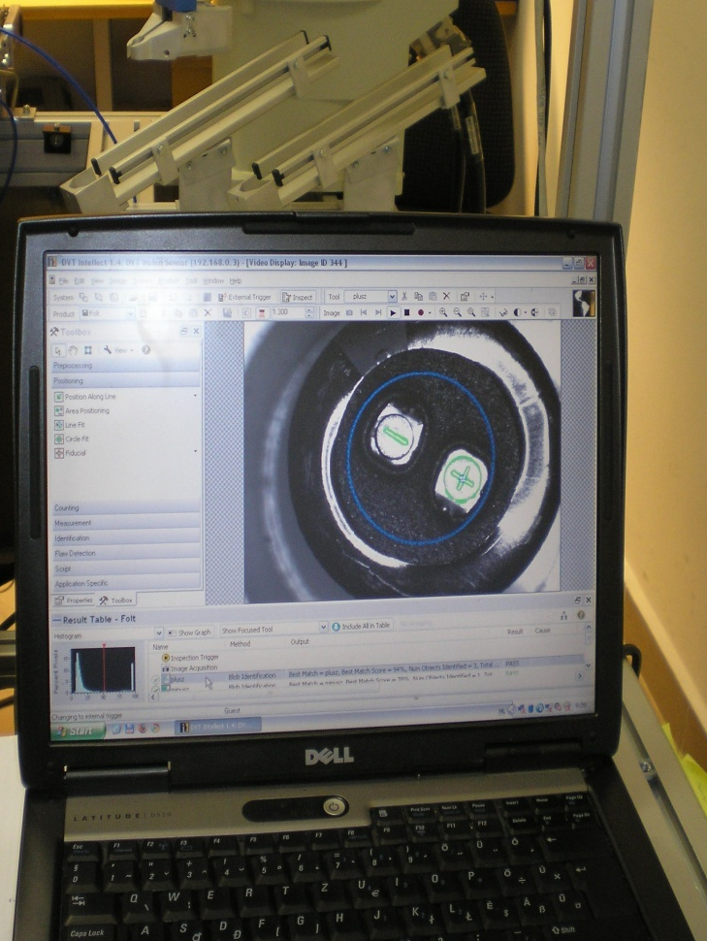
Mechatronics and Vehicle Engineering
Visual module in a robot system

Slide 19
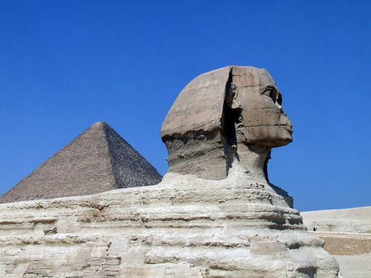
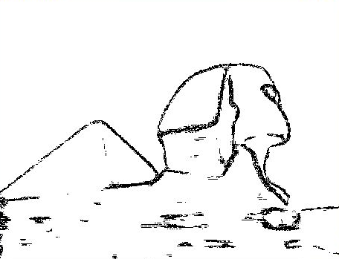
Mechatronics and Vehicle Engineering
Image processing
Fuzzy corner detection
Fuzzy image information measurement
Situational image quality improvement
High dynamic range image quality improvement
High dynamic range image synthetization

Slide 20
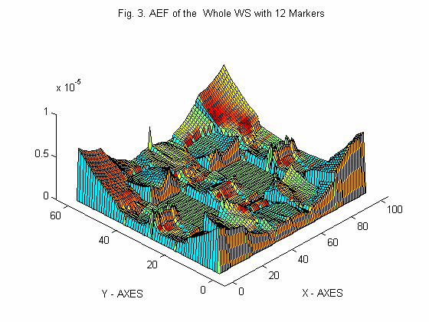
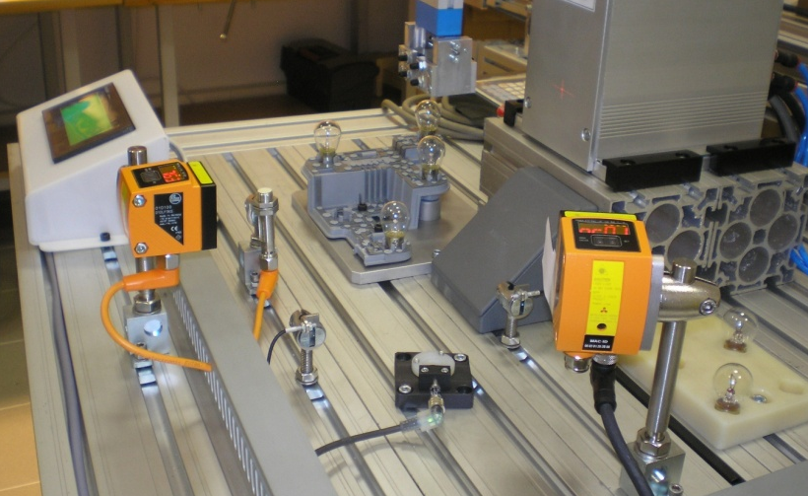
Mechatronics and Vehicle Engineering
Autonomous robot navigation (static, dynamic environments)
Mobile robot localization
Mobile robot path planning
Robotic handling and assembly
MLE

Slide 21
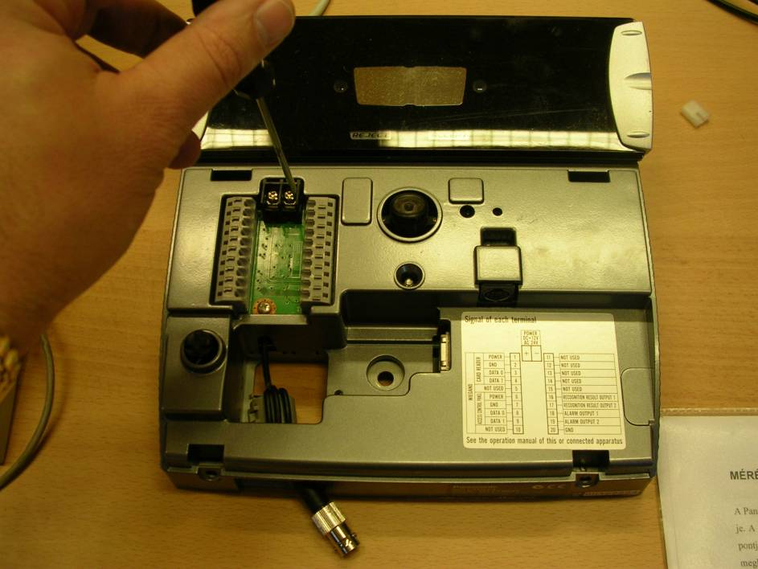
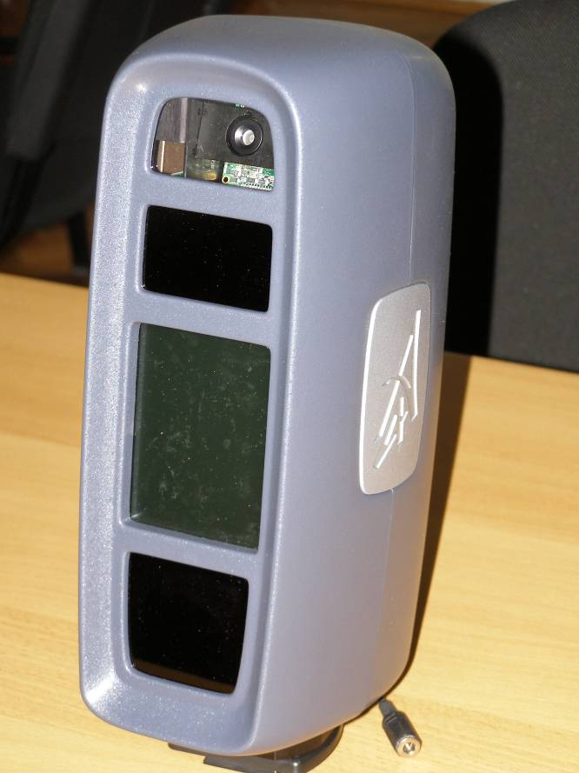
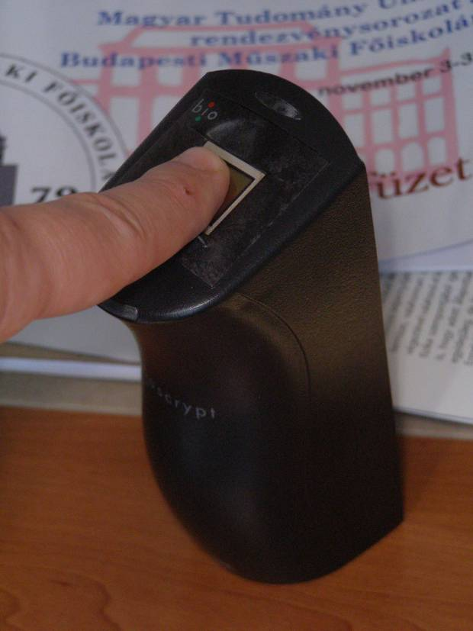
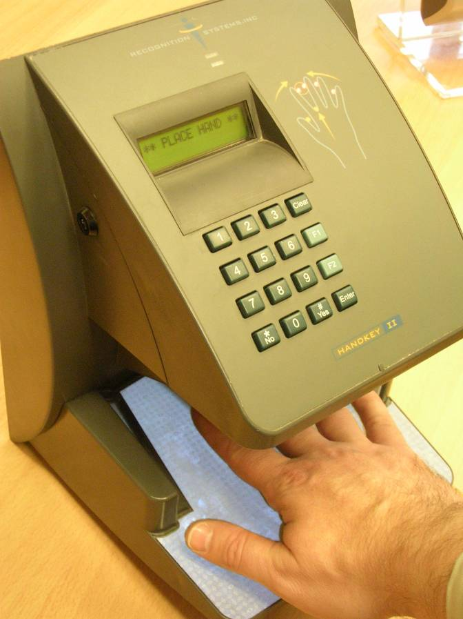
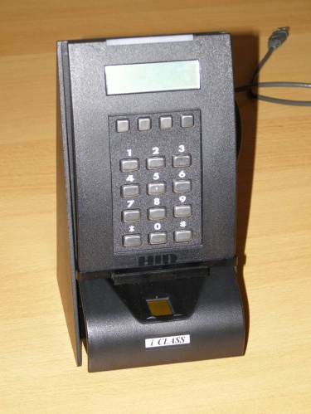
Machine Design and Safety Engineering
Safety and security devices
Biometric identification

Slide 22
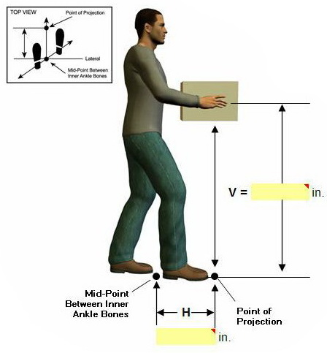
Machine Design and Safety Engineering
Research and development on ergonomics
Work place ergonomics
Human Factors Engineering
Rehabilitation Ergonomics
Health Promotion

Slide 23
PhD studies at the PhD School on Safety and Security Sciences

Slide 24
PhD program of the Doctoral School
Bologna system of education
1st phase: BSc: full-time, correspondence, and part- time course; 7 semesters
2nd phase: MSc: full-time, and correspondence course; 4 semesters
3rd phase: PhD program - full-time or correspondence course; 6 semesters (3 years)

Slide 25
Doctoral Schools of University
Three doctoral programs
- Doctoral School of Applied Informatics and Applied Mathematics
- Doctoral School of Material Sciences and Technologies
- Doctoral School of Safety and Security Sciences.

Slide 26
University Regulations for PhD Education
Regulations, processes:
MSc degree,
courses, research, publish papers
admission exam
PhD education for 3 years - 180 credits - absolutorium
PhD thesis
final PhD defense
Doctoral Council of the University

Slide 27
Visual module in a robot system

Slide 28
Safety and security devices Biometric identification

